Slide 1

Title Slide: The Importance of Filing Your Tax Return Correctly
Presented by Dr. Lotfali Pour
[Image Placeholder: Professional headshot of Dr. Lotfali Pour] The Importance of Filing Your Tax Return Correctly

Slide 2

Agenda
Key Topics to be Addressed:
Consequences of errors in tax filing
Strategies for accurate tax return filing
The role of professional assistance in tax compliance
Common mistakes in tax filing
Financial impact of accurate filing

Slide 3

Understanding Tax Returns
What is a Tax Return?: A tax return is a form used to report income, deductions, and credits to determine the amount of tax owed or the refund due.
Purpose of Tax Returns:
To calculate and pay income taxes
To claim eligible deductions and credits
To comply with tax laws and regulations
Importance of Compliance: Compliance with tax regulations is crucial to avoid penalties and legal issues. Accurate tax filing ensures you meet your legal obligations.

Slide 4

Legal Obligations and Penalties
Legal Responsibilities: Filing tax returns is a legal obligation for individuals and businesses. Failure to comply can result in severe consequences.
Potential Penalties:
Fines: Monetary penalties for late filing or underpayment of taxes.
Interest: Charges on unpaid tax amounts.
Legal Action: In severe cases, tax evasion can lead to criminal charges.
Avoiding Penalties: Accurate and timely filing is essential to avoid penalties and maintain compliance.

Slide 5

Common Mistakes in Tax Filing
Frequent Errors: Taxpayers often make mistakes that can lead to penalties or missed opportunities.
Misreporting Income: Failing to report all sources of income.
Neglecting Deductions: Overlooking eligible deductions and credits.
Incorrect Filing Status: Choosing the wrong filing status.
Mathematical Errors: Simple calculation mistakes.
Consequences: These errors can result in underpayment of taxes, leading to penalties and interest charges.

Slide 6

The Financial Impact of Accurate Filing
Maximizing Refunds: Accurate tax filing ensures you receive the maximum refund you are entitled to.
Minimizing Liabilities: Properly claiming deductions and credits can reduce your tax liabilities.
Overall Financial Health: Correct tax return submission contributes to better financial planning and stability.

Slide 7

Documentation and Record-Keeping
Importance of Proper Records: Maintaining accurate records is crucial for supporting claims made in tax returns.
Essential Documents:
Income Statements: W-2s, 1099s
Receipts: For deductions and credits
Bank Statements: To verify income and expenses
Benefits: Proper documentation helps avoid audits and ensures accurate filing.

Slide 8

Tax Deductions and Credits
Common Deductions:
Home Office Deduction: For self-employed individuals.
Student Loan Interest Deduction: For eligible student loan interest payments.
IRA Contributions: Deductions for contributions to traditional IRAs.
Common Credits:
Child Tax Credit: For qualifying children.
Earned Income Tax Credit: For low-to-moderate income individuals and families.
Education Credits: For eligible education expenses.
Tax Savings: Understanding and utilizing these deductions and credits can lead to significant tax savings.

Slide 9

The Importance of Professional Assistance
Benefits of Consulting Tax Professionals: Tax professionals provide expertise and guidance for complex tax situations.
Tax planning and preparation
Audit representation
Tax law compliance
Ensuring Compliance: Professional assistance ensures compliance with tax laws and minimizes the risk of errors.

Slide 10
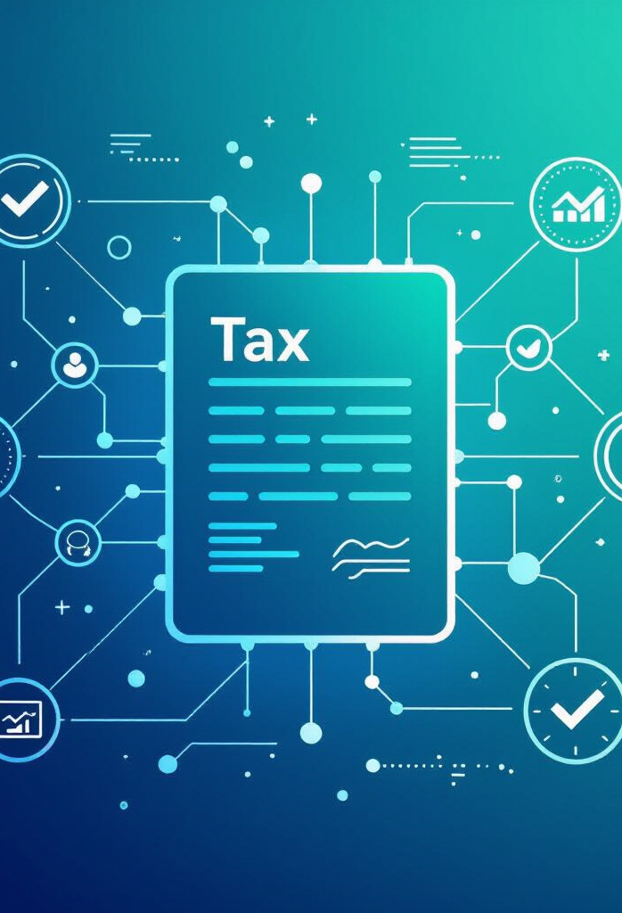
The Role of Technology in Tax Filing
Tax Preparation Software: Software like TurboTax and H&R Block can simplify the tax filing process.
Online Filing Services:
IRS Free File
TaxAct
Benefits:
Accuracy
Ease of Submission
Convenience

Slide 11

Preparing for Future Tax Seasons
Streamlining the Process: Proactive steps can simplify tax filing in future years.
Regular Financial Reviews: Monitor income and expenses throughout the year.
Organized Record-Keeping: Maintain organized records of income and deductions.
Tax Planning: Consult with a tax professional for proactive tax planning.

Slide 12


Case Studies of Tax Filing Consequences
Case Study 1: Misreported Income
Case Study 2: Accurate Filing
A taxpayer failed to report income from a side business, which led to penalties and interest charges. This highlights the importance of reporting all sources of income to avoid legal and financial repercussions. The consequences of incorrect filing can be severe, including fines and additional payments.
A taxpayer claimed all eligible deductions and credits, resulting in a significant tax refund. This case demonstrates the benefits of precise submissions. By taking advantage of available deductions and credits, taxpayers can reduce their tax liability and receive a refund, showcasing the importance of understanding and utilizing tax laws correctly.

Slide 13
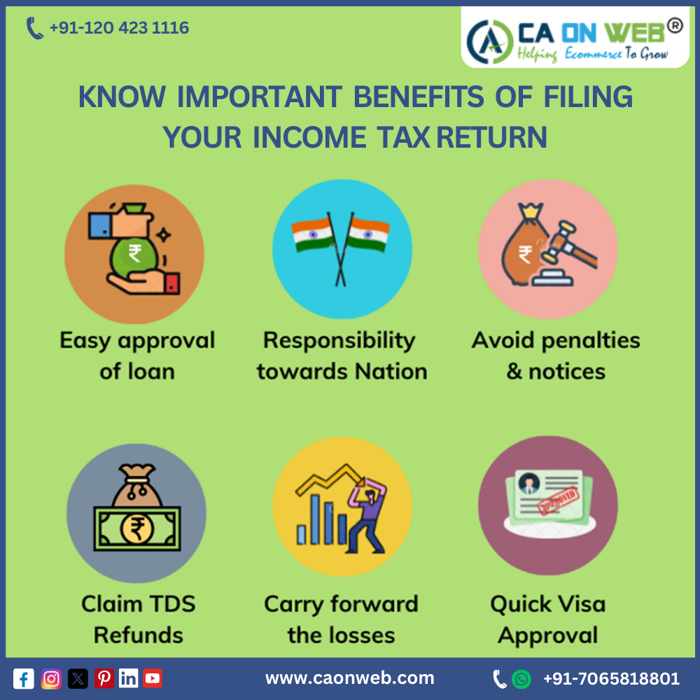
Conclusion
Summary of Critical Points:
Accurate tax filing is essential for compliance and financial health.
Common mistakes can lead to penalties and missed opportunities.
Professional assistance and technology can aid in accurate filing.
Reinforcing Importance: Filing tax returns correctly is crucial for personal and professional finance.

Slide 14

Key Takeaways
Important Lessons Learned:
Understand your legal obligations.
Maintain accurate records.
Utilize available deductions and credits.
Seek professional assistance when needed.
Use technology to simplify the filing process.

Slide 15

Q&A
Open Floor for Questions
[Open the floor to the audience for questions and clarifications.]

Slide 16

Thank You
Closing Remarks
Thank you for your attention. We encourage a responsible approach to tax filing.

Slide 17
Final Note: Work comfortably with Hasban Plus
Hasban Plus
Consider Hasban Plus as a partner for effective tax management and advice.

